Slide 1
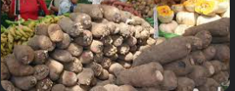
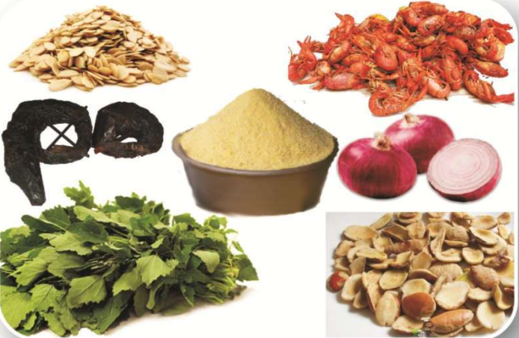
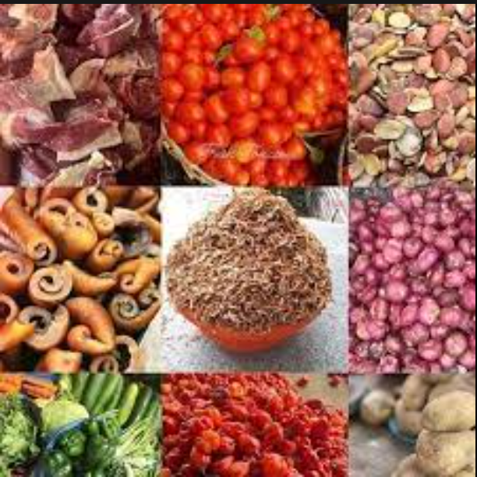
Rebranding Businesses through Sentiment Analysis (Case study: African Businesses in Alberta) by Abi Afolabi 14th September 2023

Slide 2
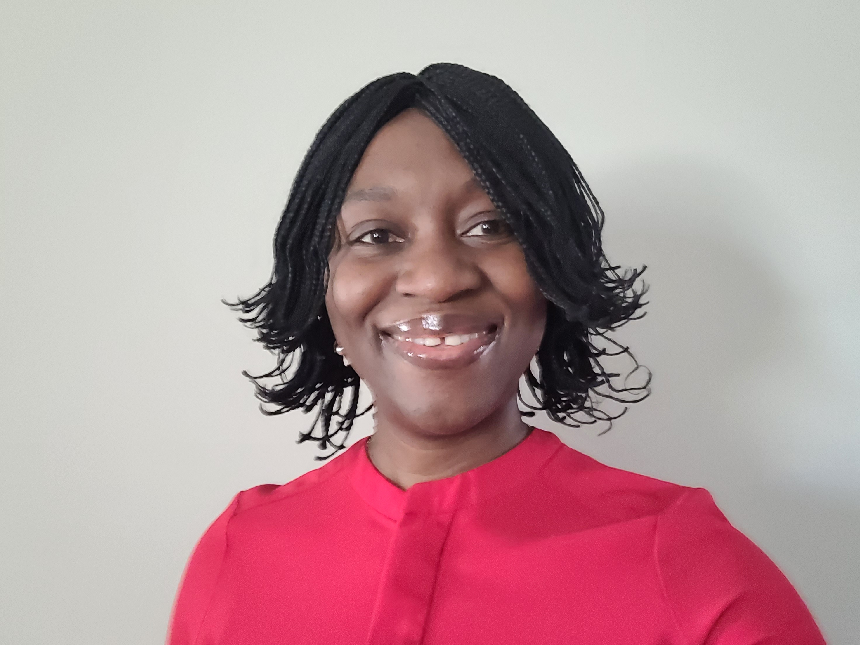



About Me….
aaafolab@ualberta.ca
www.linkedin.com/in/abi-adebowale
https://github.com/AbiAfolabi?tab=repositories
Geoscientist & Data Analyst

Slide 3


Objectives
Showcase and reinforce learnings:
API in data gathering.
sentiment analysis to support business growth.

Slide 4
Project Execution Steps
Data
Gathering (API)
Cleaning &
EDA
Result Comparison
& Conclusion
Sentiment Analysis
Preprocessing
Notes:
POIs are Restaurant & Employment Services

Slide 5
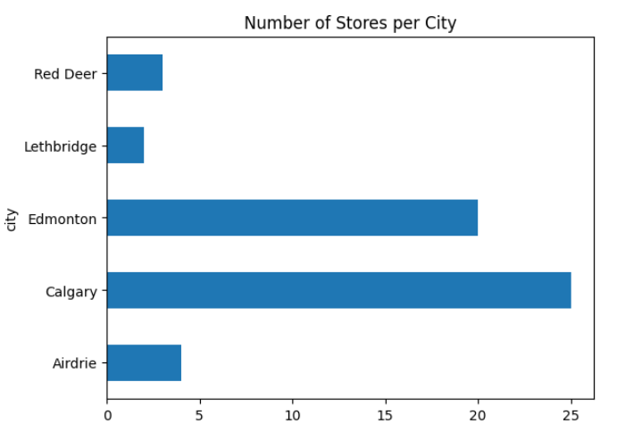
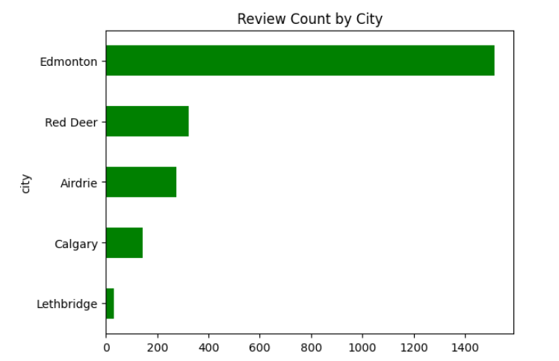
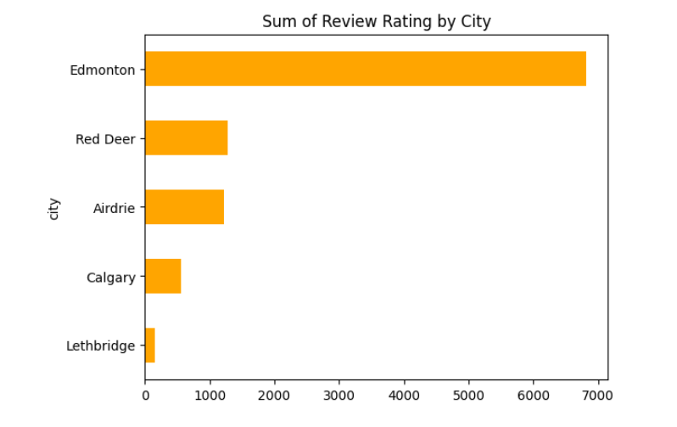
Discoveries from EDA (1)
Notes:
Calgary has the highest number of African businesses
Edmonton has the highest number of reviews, >> than reviews in Calgary with a higher number of businesses

Slide 6
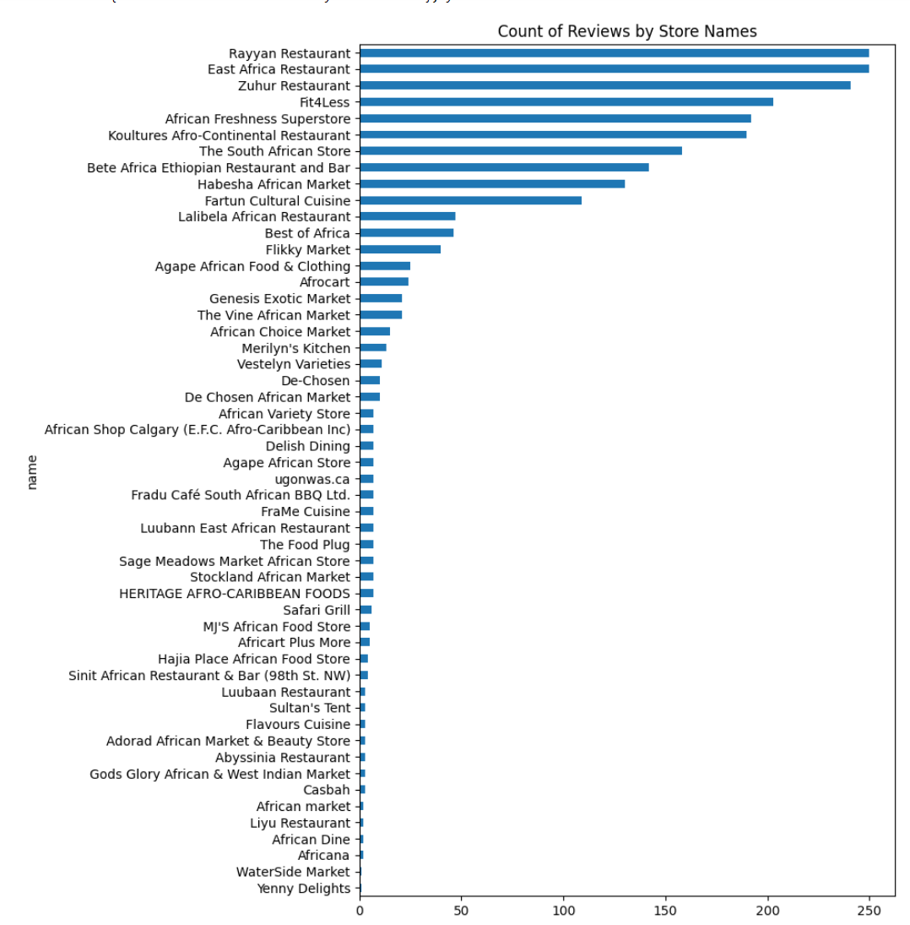
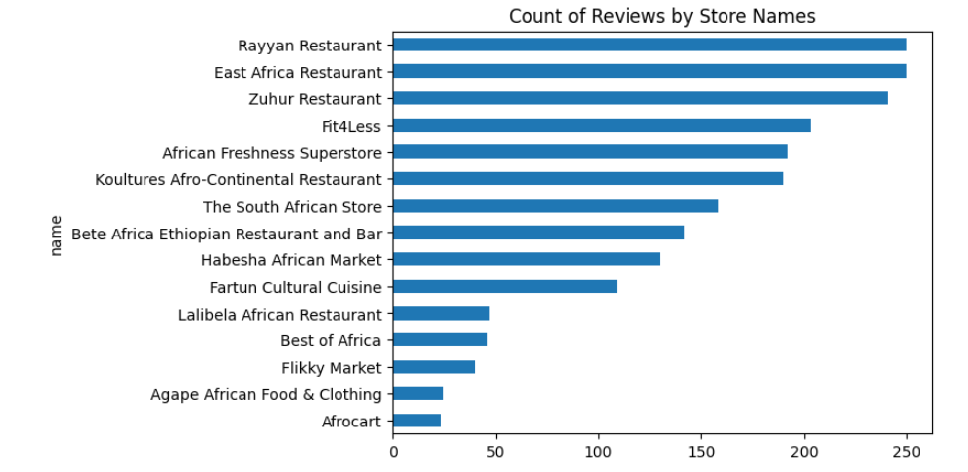
Discoveries from EDA (2)

Slide 7
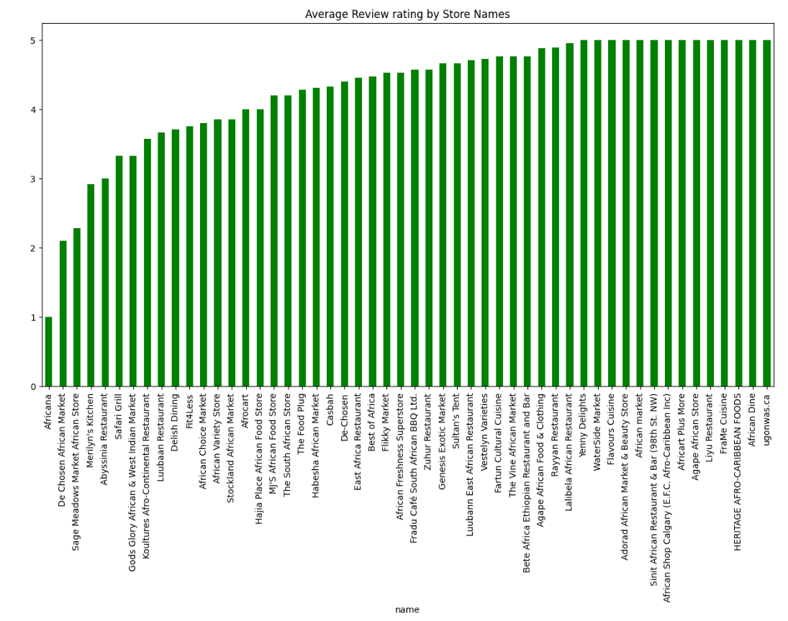
Discoveries from EDA (3)

Slide 8
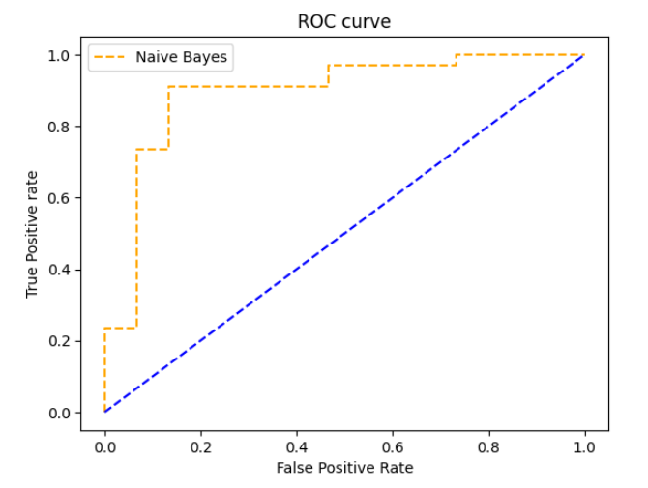
Sentiment Analysis
Naïve Bayes model
10% of dataset manually labelled
Naïve Bayes model
VADER model
(Valence Aware Dictionary for sEentiment Reasoning)
BERT model
(Bidirectional Encoder Representations from Transformers)
Pre-trained models

Slide 9
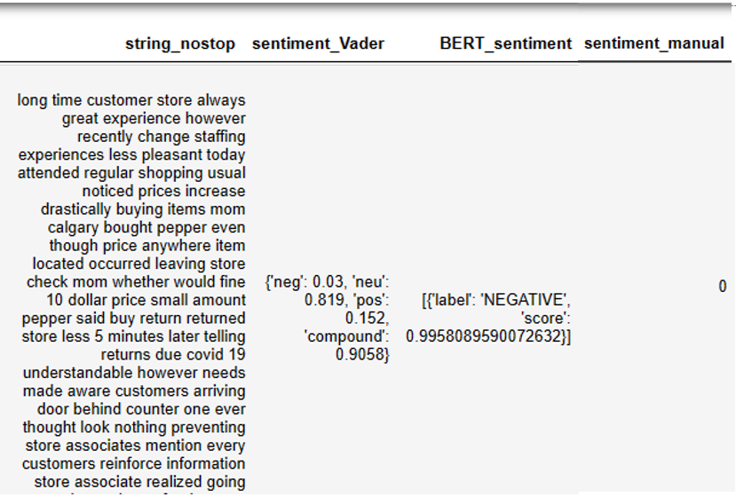
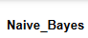


Comparison of Results (1)

Slide 10
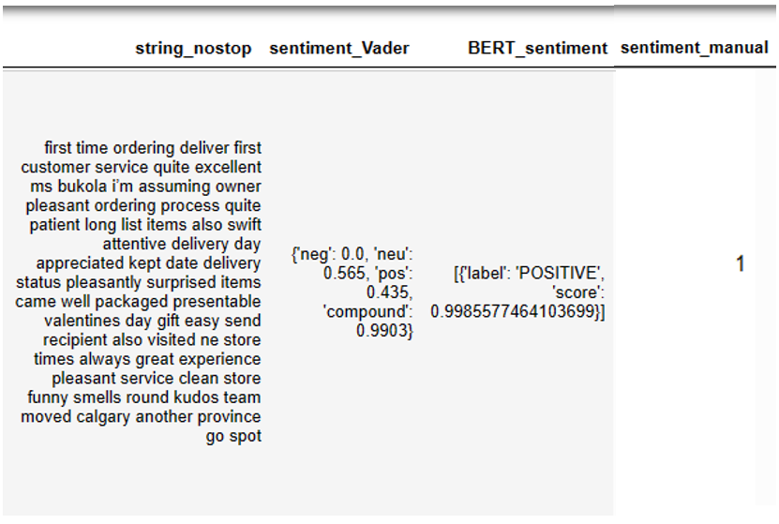
Comparison of Results (2)

Slide 11
Results & Conclusion
African stores have potential to grow into chains.
BERT & Naïve Bayes Models performed better in sentiment classification.
Future work – break down reviews into separate sentences (or phrases).

Slide 12

